Slide 1
ArtInfo – Art History App for Art Galleries
William Kim

Slide 2
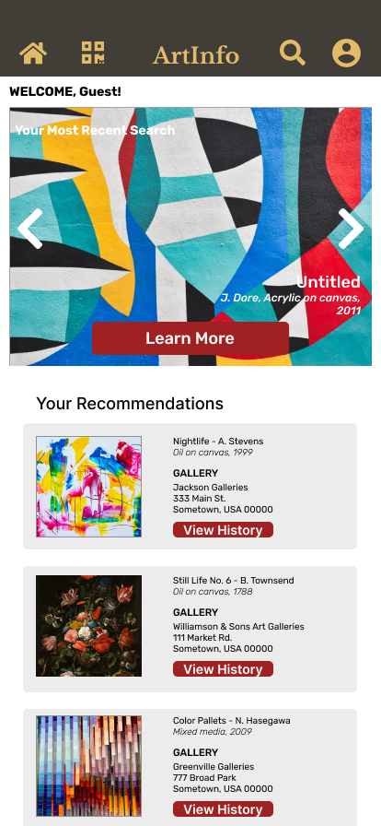
Project overview
The product:
This app is an art history of artwork that is exhibited in a local art gallery. This app provides deeper immersion to visitors in addition to view artwork in the gallery.
Project duration:
April 2021 to November 2021

Slide 3
Project overview
The problem:
Unlike museums and larger art galleries, local art galleries are generally operated in a smaller space and run by private individuals. This presents challenges where local art gallery does not posess resources that museums and larger art galleries that have, such as staff members, information medium, etc.
The goal:
This app intends to solve this problem by providing as a resource for art gallery owners and visitors that is usually found at museum, such as tour guide, art information, etc.

Slide 4
Project overview
My role:
UX Generalist
Responsibilities:
User research
Wireframing
Prototyping

Slide 5
User research
Personas
Problem statements
User journey maps
Understanding
the user

Slide 6
User research: summary
Based on the research conducted, the primary users were art gallery visitors who wants to know more information of the artwork as well as small art gallery owners who wish to provide resources to visitors that only museums are capable of.
Another information discovered is that the other potential user group include art customers who are interested in purchasing the artwork, and artist who wishes to display their artwork. Even though these groups are not primary user groups, we believe that the app also benefit these groups as well.

Slide 7
User research: pain points
1
2
Lack of information
Lack of resources
Small art galleries often do not have information on the artworks they display.
Small art galleries often do not have resources that museums or larger art galleries have.

Slide 8
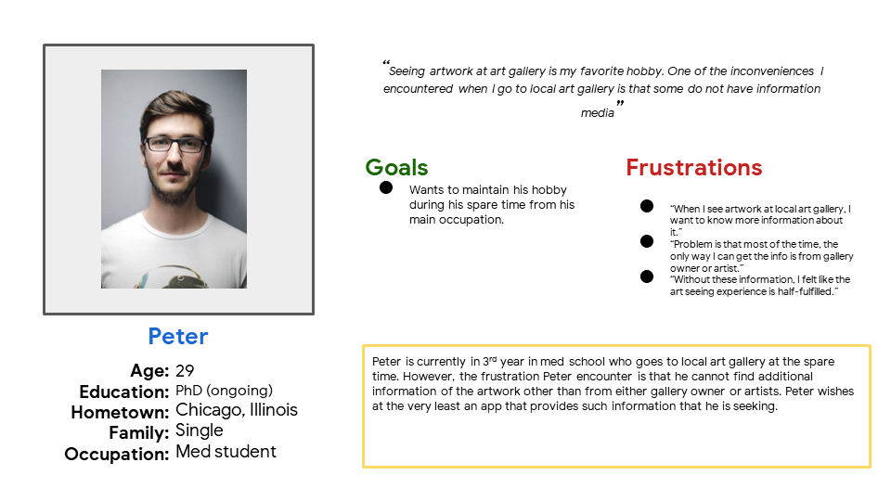
Persona: Peter
Problem statement:
Peter is a art gallery visitor who needs an app that provides art information.

Slide 9
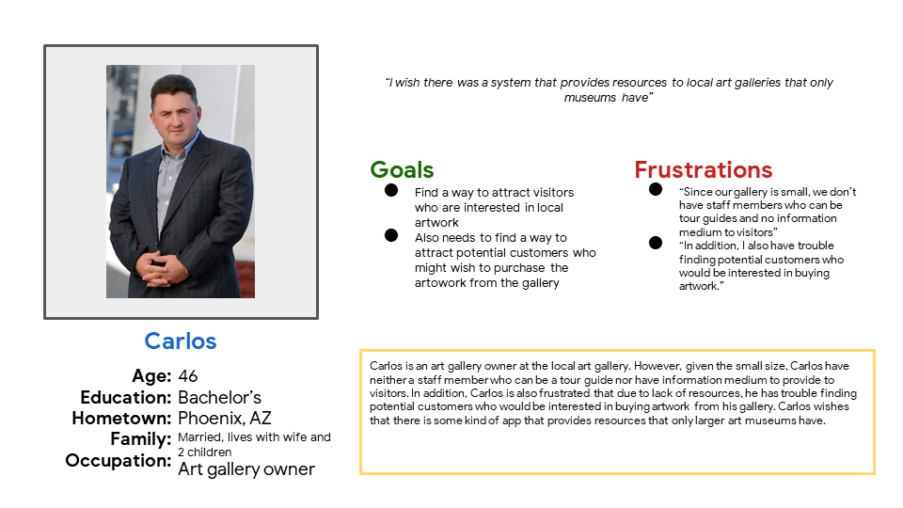
Persona: Carlos
Problem statement:
Carlos is an art gallery owner who needs a resource that museums have because he has trouble attracting visitors and customers.

Slide 10
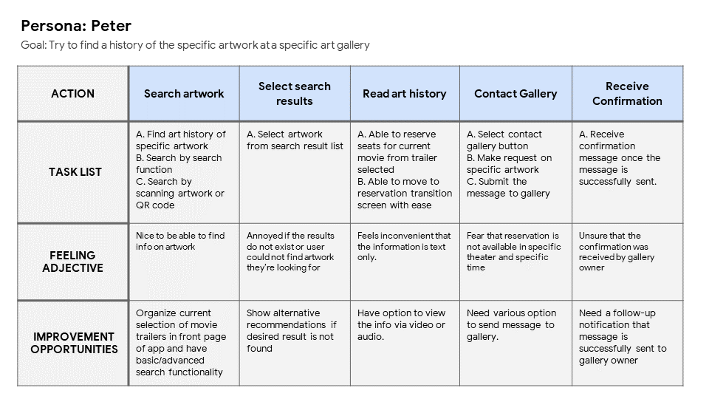
User journey map
Mapping Peter’s user journey reveals required basic feature needed in ArtInfo app.
Image of user journey map

Slide 11
Paper wireframes
Digital wireframes
Low-fidelity prototype
Usability studies
Starting
the design

Slide 12
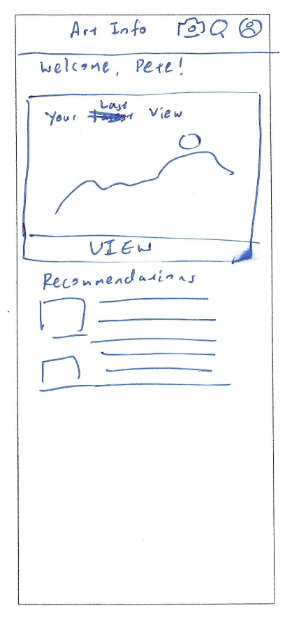
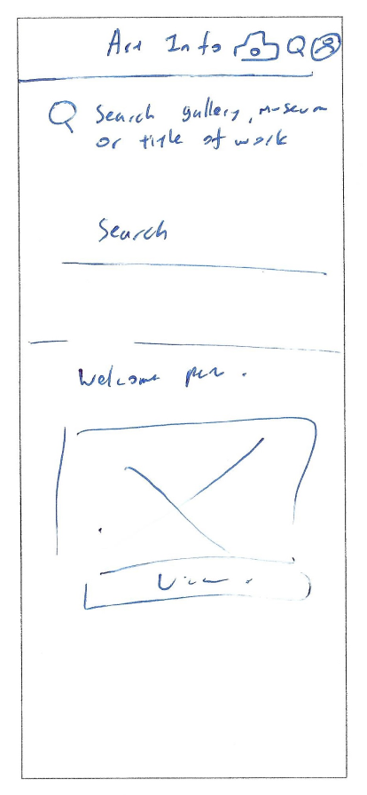
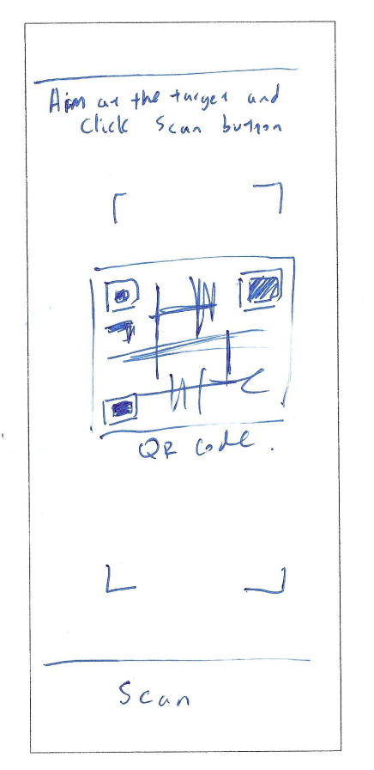
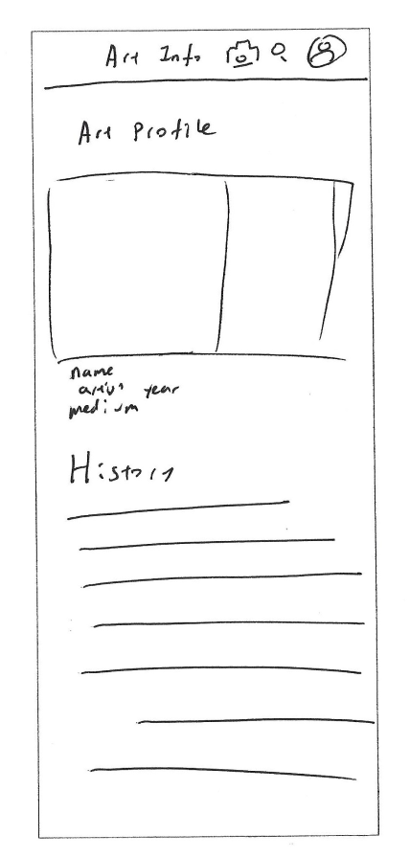
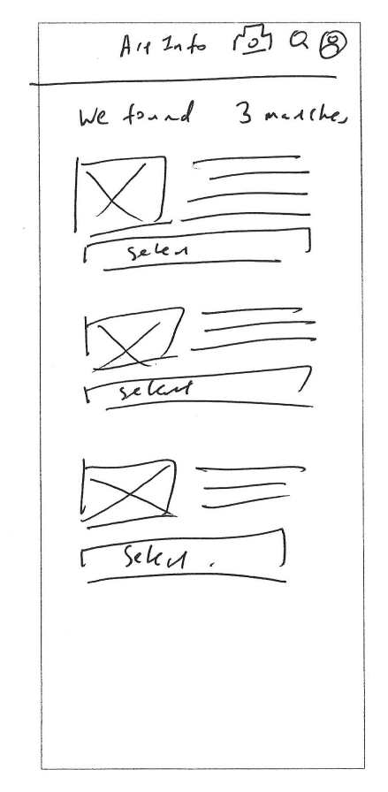
Paper wireframes
In this wireframe, I have considered two options to find the information: by search function or by scan. That way, these options would provide flexibility for users to search info on artwork at their convenience.
Image of paper wireframes including five different versions of the same screen and one image of the new, refined version

Slide 13
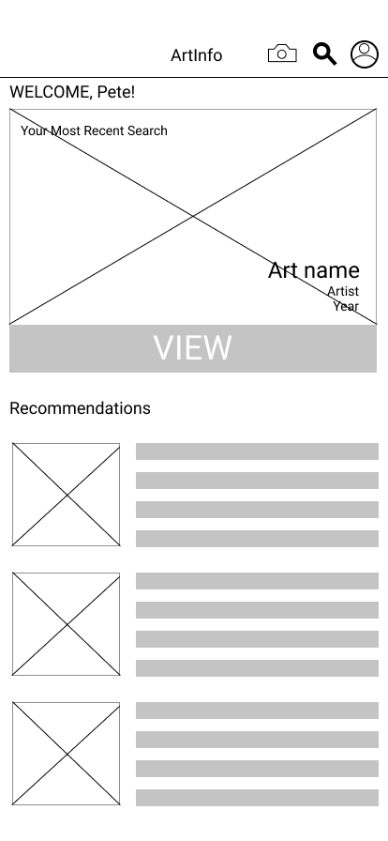
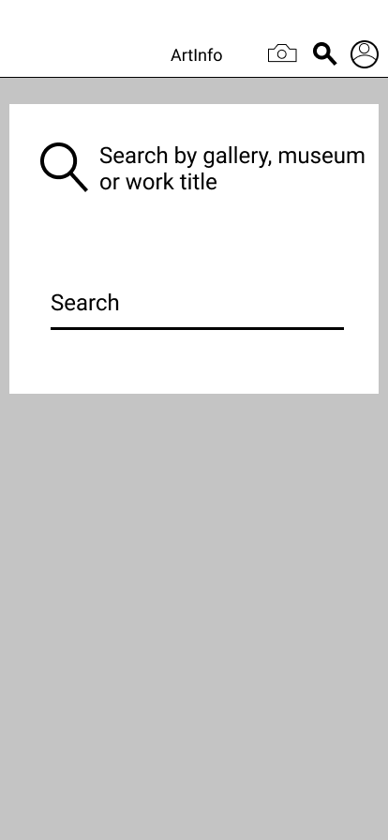
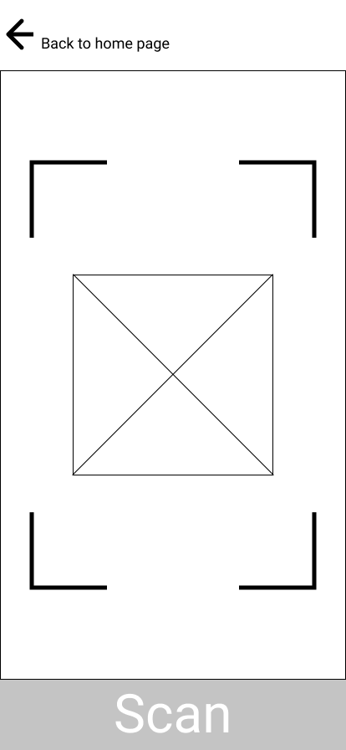
The search by typing and scan is placed on top for convenience
Digital wireframes
Continuing from paper wireframes, the elements in the paper wireframes are translated to digital wireframes. In this case, the ability to have multiple option to search is retained in digital wireframes.

Slide 14
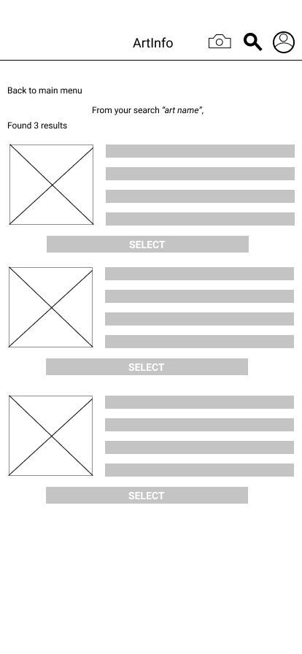
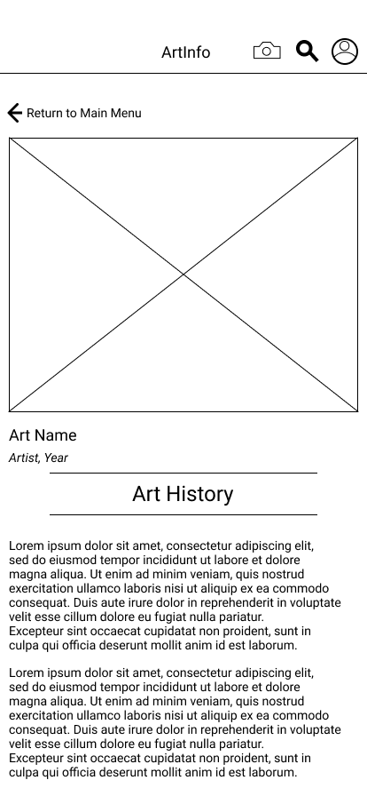
Digital wireframes
After the user searched the artwork, the result list shows up and user can access art history section from search results.
Description of the element and its benefit to the user
Description of the element and its benefit to the user

Slide 15
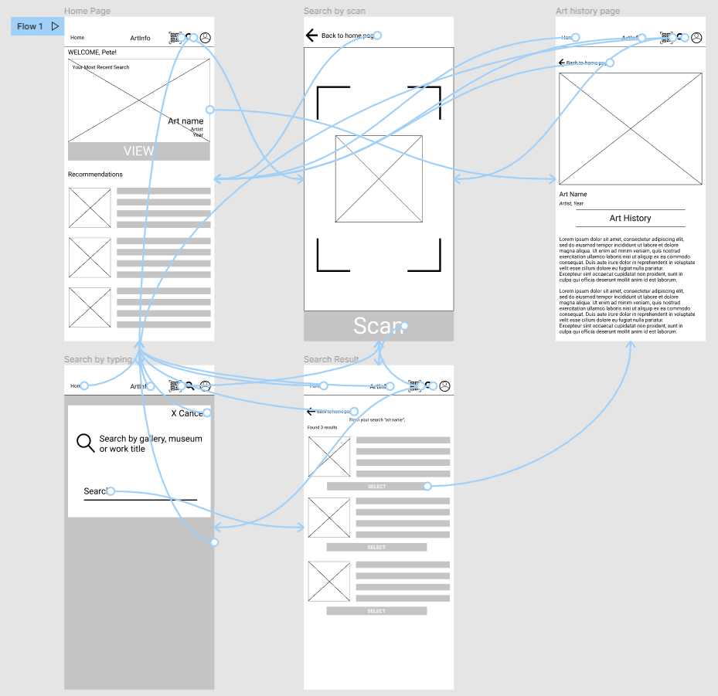
Low-fidelity prototype
Low fidelity prototype where user accesses art history of the specific artwork through user flow.
View of prototype:
ArtInfo – Low-fidelity prototype
Screenshot of prototype with connections or prototype GIF

Slide 16
Usability study: findings
I conducted usability studies where the finding is organized into 2 groups, where first group finding represents high-priority improvement to prototype, where second group represents lower-priority improvement to prototype.
Group 1 findings
Group 2 findings
1
Home button is missing
1
Cancel button did not exist
2
Scan icon was confusing
2
Button wording was confusing

Slide 17
Refining
the design
Mockups
High-fidelity prototype
Accessibility

Slide 18
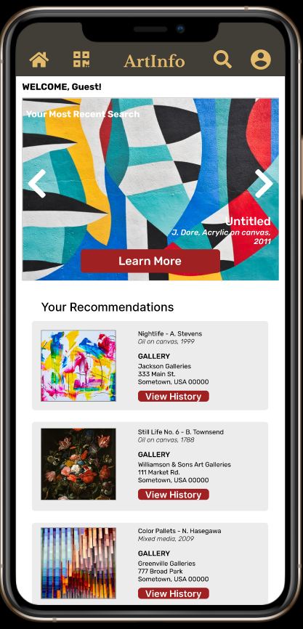
Mockups
Before usability study
After usability study
After the usability studies, participants noted that either buttons were confusing or did not exist at all. In this case the icon for scan is replaced from camera icon to QR icon to indicate scan. In addition, the Home icon is added which was not present in earlier mockups.
Image of selected screen before usability study
Image of selected screen after usability study

Slide 19
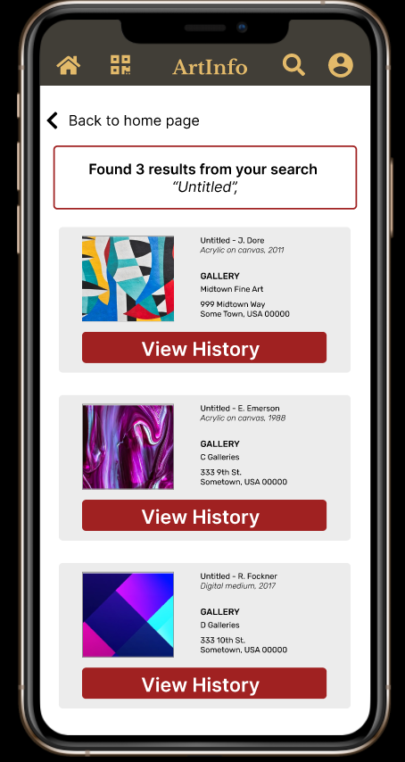
Mockups
Before usability study
After usability study
After the usability study, it was determined that the groups from search results need to be organized by gestalt principles, where the boundaries and groupings were established to differentiate one item to another.
Image of selected screen before usability study
Image of selected screen after usability study

Slide 20
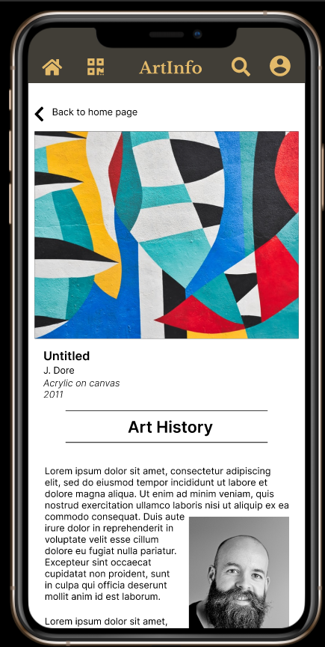
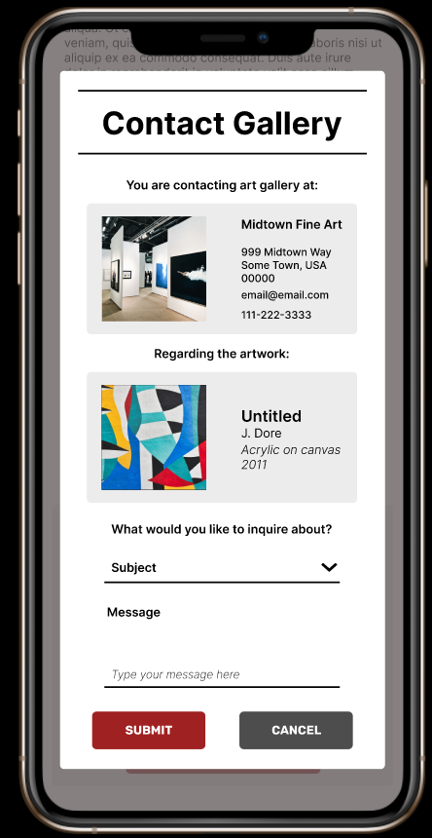
Mockups
Main mockup screen for display
Main mockup screen for display
Main mockup screen for display
Main mockup screen for display

Slide 21
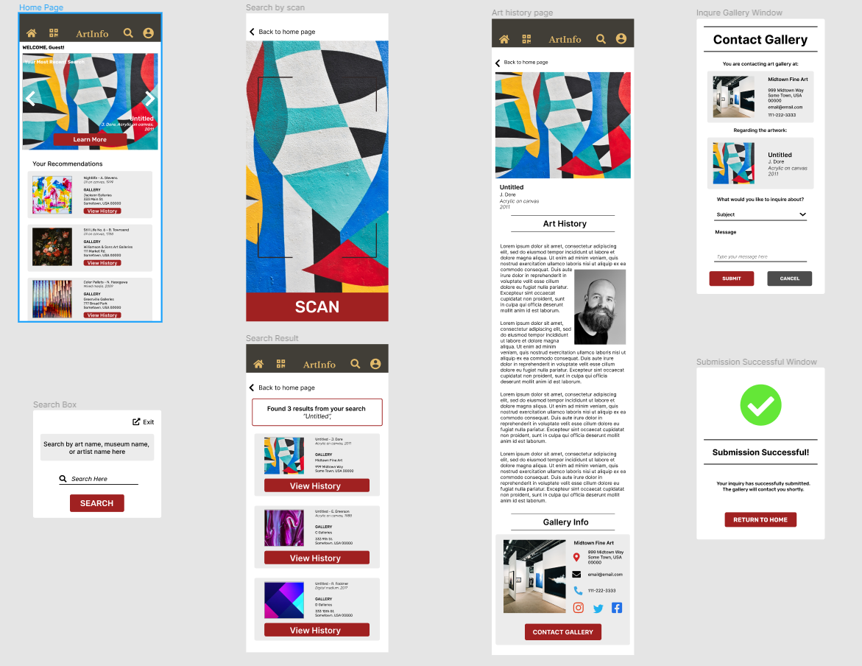
High-fidelity
prototype
The high-fidelity prototype made numerous improvements based on the feedback from participants as well as adding additional features.
View ArtInfo:
ArtInfo – High-fidelity
Screenshot of prototype with connections or prototype GIF

Slide 22
Accessibility considerations
1
2
Adjusted color pallet that accomodiates color-blind users.
Needs a feature that includes videos and audio options for hearing-impared and visually impaired, respectively.

Slide 23
Going forward
Takeaways
Next steps

Slide 24
Takeaways
Impact:
We believe the app would truly provide resources for local art galleries that mutually benefit both visitors and gallery owners alike.
One quote from feedback was:
“[…while the app has some parts need improvement], the app is actually easy to navigate.”
What I learned:
What I learned is that even making significant improvements on the ArtInfo app from low-fidelity to high-fidelity prototype, further refinements are necessary, including additional features, improved iteration through usability studies and user feedback.

Slide 25
Next steps
1
2
Conduct more user research to determine additional features in the app.
Conduct another usability study in high-fidelty prototype to further refine the app.

Slide 26
Insert a few sentences summarizing the next steps you would take with this project and why. Feel free to organize next steps in a bullet point list.
Let’s connect!
Thank you for your review of the ArtInfo app! If you wish to contact me for questions or information, my information is provided below:
Email: wkim@wkuxdesign.com
Website: www.wkuxdesign.com

Slide 27
Thank you!

